Slide 1

App Overview Digital Grid – Asset Health
As of may 2017

Slide 2
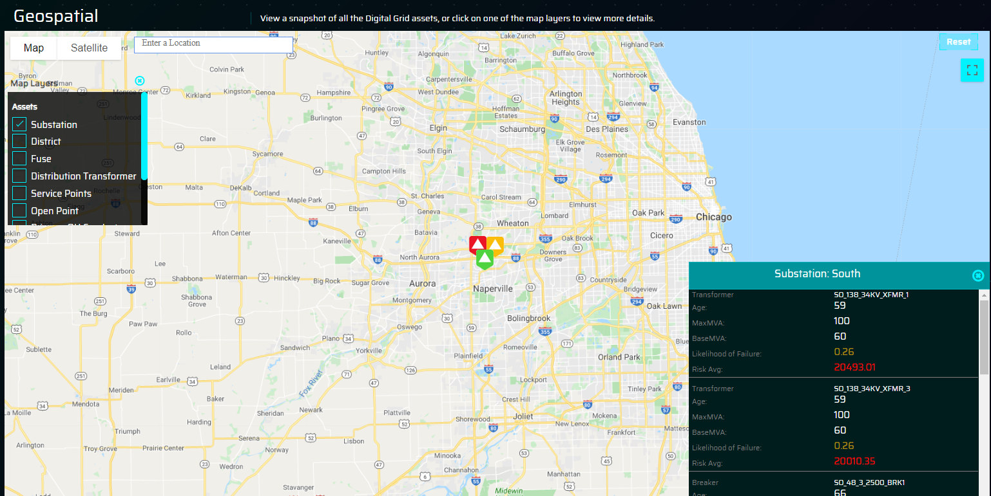
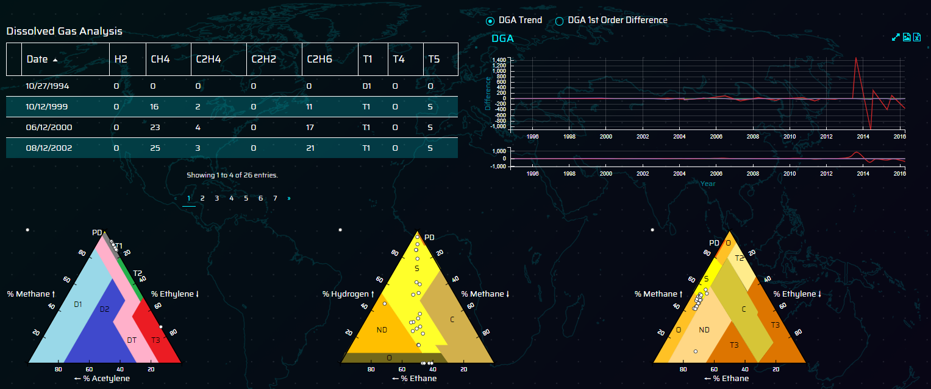
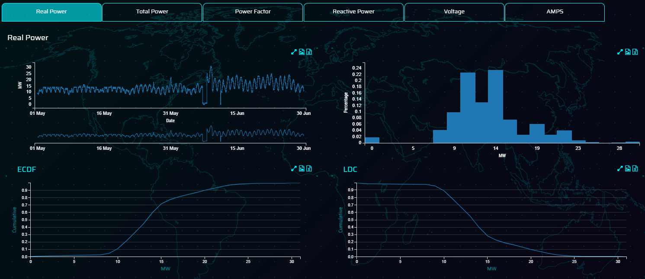
Asset health | Introduction
Application Complexity: Complex
Digital Gird Asset Health app enables utilities to get a holistic risk based view across their complete network and make better maintenance and investment decisions
Asset Health enables a utility to assess the risk profile of the assets within the network to enable better maintenance strategies, investment decisions to be made. This is designed to enable asset management planners to easily assess existing and future investment decisions.
Value Drivers
Analytics Enablers
Impact Range
Reduce Maintenance
Condition based maintenance
Predictive Failure Models
5%
Executive Summary
Value Framework
Optimized Grid Capacity
Reduce Downtime
5%
Business Value
Reduce Capital Investment
Better use of Existing Assets
Single View of Assets
10%
Large US Utility
URD cables
Large US Utility
asset risk analytics
European Utility
advanced renewables maintenance strategies
Capital spend reduction
Greater Transparency of Asset Health & Risk
5 - 10%
Application
Client Success
Reduce Maintenance Cost
10 – 20%
-9%
Notes:
App Overview: Slide 1

Slide 3
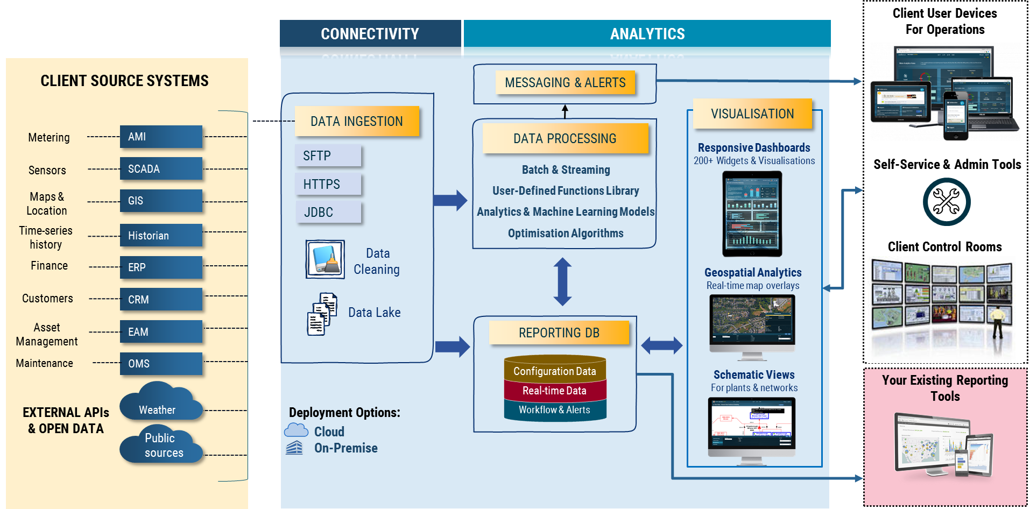
Asset health | Technical Information
Digital Gird Asset Health app enables utilities to get a holistic risk based view across their complete network and make better maintenance and investment decisions
Data Stores
Blob storage
Hadoop
MySQL
Geoserver
Processing
Spark
R
Python
Web Application
Java / Python APIs
Spring data security framework
Geospatial & schematic
HTML5/D3 web application
Analytical model integration
Technologies Used
Solution Architecture
For existing asset classes, implementation in 8 weeks, new asset classes 12 weeks including development of failure models
Integration of data pipelines rather than systems, accelerates implementation time
Workflow integration: connect with existing client maintenance business processes
Enables users to access all the data ingested in a single system to ease root cause analysis and avoiding multiple system hops
Methodology: will vary depending on the asset class and completeness of data available. Failure models maturity will be dependent on data completeness but maturity will range from heuristic scoring to Weibull failure curves by asset class
Assets: Failure models created for 12 main asset classes
Methodologies and Assets
Solution Highlights
For further detailed information please contact Pre-Sales Support team
Notes:
From Product Sheet

Slide 4
Asset health | Analytics Journey to ROI
Digital Grid - Asset Health is designed to give a system wide overview of the network risk based on industry analytical models to allow the utility to achieve regulatory targets, improve reliability and increase capital effectiveness. It brings together data from across the utility to enable users to have a single application for asset health and asset investigation.
End to End Analytics Journey to ROI
Business Context
Data
Analytics
Insights
Actions
Outcomes/KPIS
Pressure to reduce maintenance costs
Identify and manage risk across the network
Improve asset data quality
Optimize O&M and CAPEX expenditure
Meet regulatory demand on reliability, outage management and reporting requirements
EAM / Work order history, asset details
Operational sensor data, KV, Mvar, Amps
Lab measurements (DGA)
Inspection records
Probability of failure modelling based off Weibull curves
Consequences modelling to fit with the utility risk framework
Simulation of future events based
Ability to classify all the assets in the network according to a common risk and consequences framework
Highlights assets most at risk and the impacts that their failure may have on the network
Prioritized maintenance strategies based on actual risks to the network
Investment strategies defined to maintain agreed risk profiles across based on simulation
Lower O&M costs
Reduced Asset Risk
Increased Capital Effectiveness
Improved System Reliability
Improved Maintenance Strategies
Increased Regulatory Transparency
Increased Cust. & Worker Safety
IT Benefits – single source of data &
Agile development of future apps
Notes:
App Overview

